Slide 1


Hope to Skills
Lecture# 20
Irfan Malik, Dr. Sheraz Naseer

Slide 2
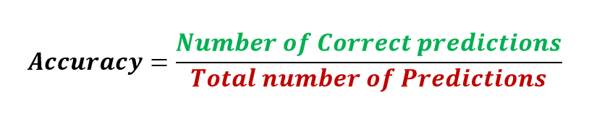
Accuracy
It is the ratio of number of correct predictions to the total number of input samples.
Note:It works well only if there are equal number of samples belonging to each class.

Slide 3
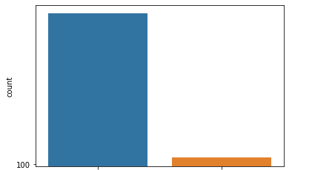
Class Imbalance
A
B
Class

Slide 4
Accuracy- Example
Consider that there are 98% samples of class A and 2% samples of class B in our training set. Then our model can easily get 98% training accuracy by simply predicting every training sample belonging to class A.
When the same model is tested on a test set with 60% samples of class A and 40% samples of class B, then the test accuracy would drop down to 60%.
Classification Accuracy is great, but gives us the false sense of achieving high accuracy.
The real problem arises, when the cost of misclassification of the minor class samples are very high.

Slide 5
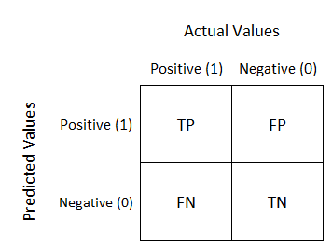
Confusion Matrix
Confusion Matrix as the name suggests gives us a matrix as output and describes the complete performance of the model.

Slide 6
Confusion Matrix
True Positives : The cases in which we predicted YES and the actual output was also YES.
True Negatives : The cases in which we predicted NO and the actual output was NO.
False Positives : The cases in which we predicted YES and the actual output was NO.
False Negatives : The cases in which we predicted NO and the actual output was YES.

Slide 7
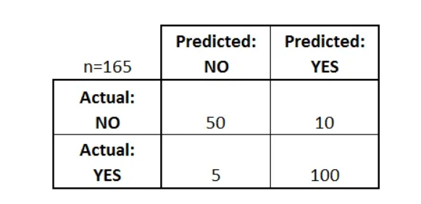
Confusion Matrix - Example
In a binary classification scenario with classes YES and NO, our own classifier's performance on 165 test samples yields the following results.

Slide 8
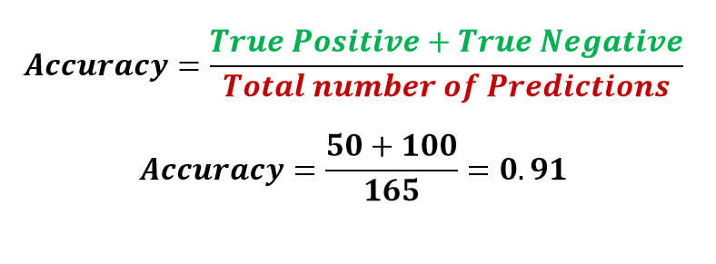
Confusion Matrix - Accuracy
Note: Only reliable when we have balanced classes

Slide 9
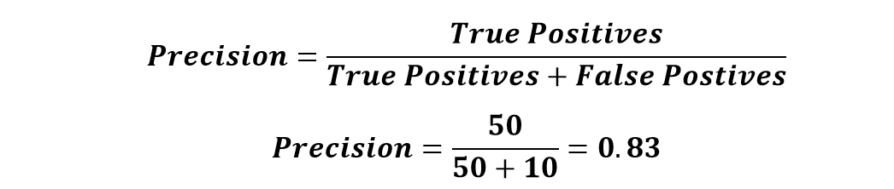
Confusion Matrix - Precision
It is the number of correct positive results divided by the number of positive results predicted by the classifier.
precision emphasizes minimizing false positives.
Use case example: Medical tests, where false positives (Predicted Diseased but actually healthy) can lead to unnecessary treatments.

Slide 10
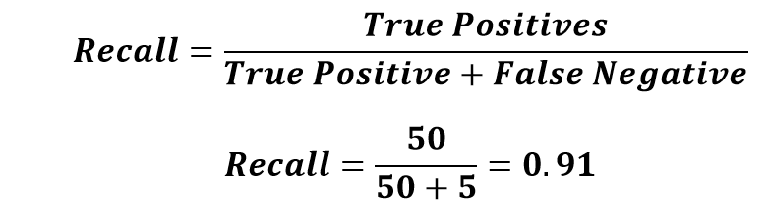
Confusion Matrix - Recall
The ratio of correctly predicted positive instances to the total actual positive instances.
Recall focuses on minimizing false negatives.
Use case example: Disease detection, where False Negative (predicted healthy but actually diseased) can have serious consequences.

Slide 11
Confusion Matrix - Example
Suppose you trained a model to classify cancer patients. You want evaluate the model performance. You have to answer the following questions Accuracy? Precision? and Recall?
What should be of more concerned Accuracy. Precision. Recall?
 | Predicted Cancer = Yes | Predicted Cancer = No
Actual Cancer = Yes | 96 | 11
Actual Cancer = No | 17 | 54

Slide 12
Real-World Examples
Fraud detection:
High precision to avoid false positives (Predicted Fraud actually not-Fraud)
Medical diagnoses:
High recall to minimize false negatives (Predicted healthy but actually diseased).

Slide 13
Key takeaways
Accuracy (total % of correct classifications) is often not a meaningful performance metric when data sets are imbalanced
Class imbalance implies that one class is represented much more often than others. Penalizing certain misclassifications and re-sampling the data set help dealing with imbalances.
Precision is a metric that penalizes false positives. As such, models with high precision are cautious to label an element as positive.
Recall is a metric that penalizes false negatives. Models with high recall tend towards positive classification when in doubt.

Slide 14
Lets move to Google collab

